Slide 1



CIS 3200 Team 2 Presentation
Hye Kim, Zehao Chen, Jesus Diaz, Shayan

Slide 2
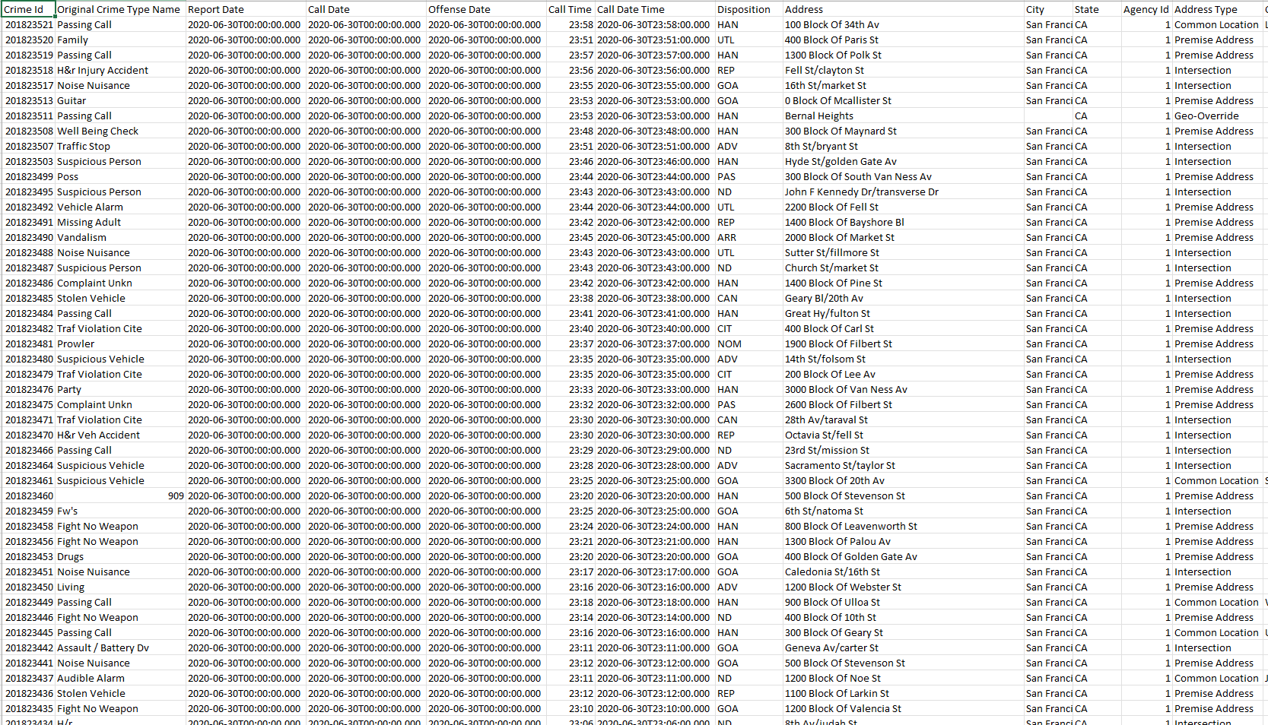
Dataset
Data size: 219MB
Data source: https://www.kaggle.com/datasets/san-francisco/sf-police-calls-for-service-and-incidents?select=socrata_metadata_police-department-incidents.json
GitHub: https://github.com/ZehaoChen3200/CIS-3200-group-2

Slide 3

SF Police Calls for Service and Incidents
This is a dataset hosted by the city of San Francisco.
The organization has an open data platform on site and they update their information according the amount of data that is brought in.

Slide 4
SF Police Calls for Service and Incidents
Our group has been analyzed and organized these data to visualize them.
The main purpose is to understand the situation of SF Police Calls for Service and Incidents in the second quarter of 2019 and the second quarter of 2020, which are just before and after the start of the pandemic. This way, we can understand the impact of the pandemic on Police Calls.

Slide 5
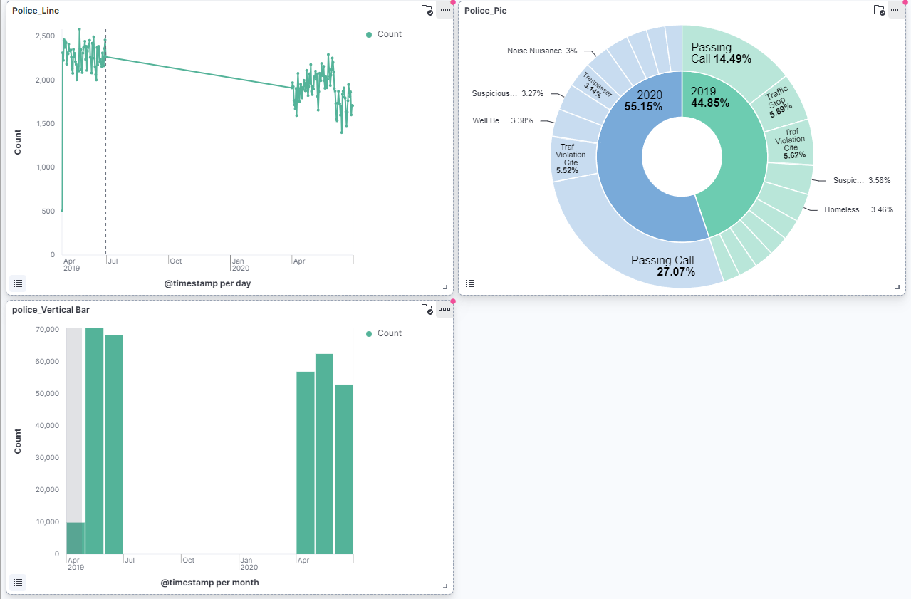
Visual representation of the number of Police Calls in two different quarters.
Each image uses different visual effects to present the data.

Slide 6
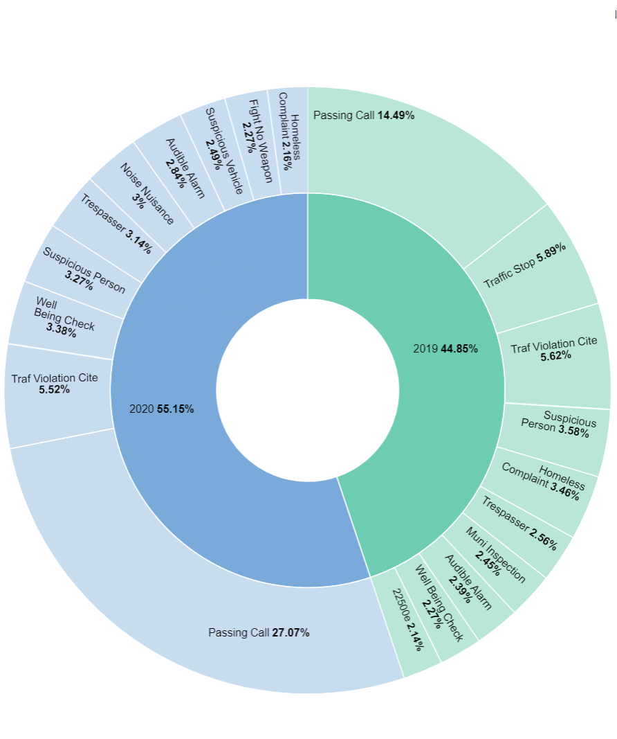
Pie Chart
This chart visualizes the proportion of Police Calls in two quarters, and the pie chart also shows the proportion of different types of Police Calls in each quarter.

Slide 7
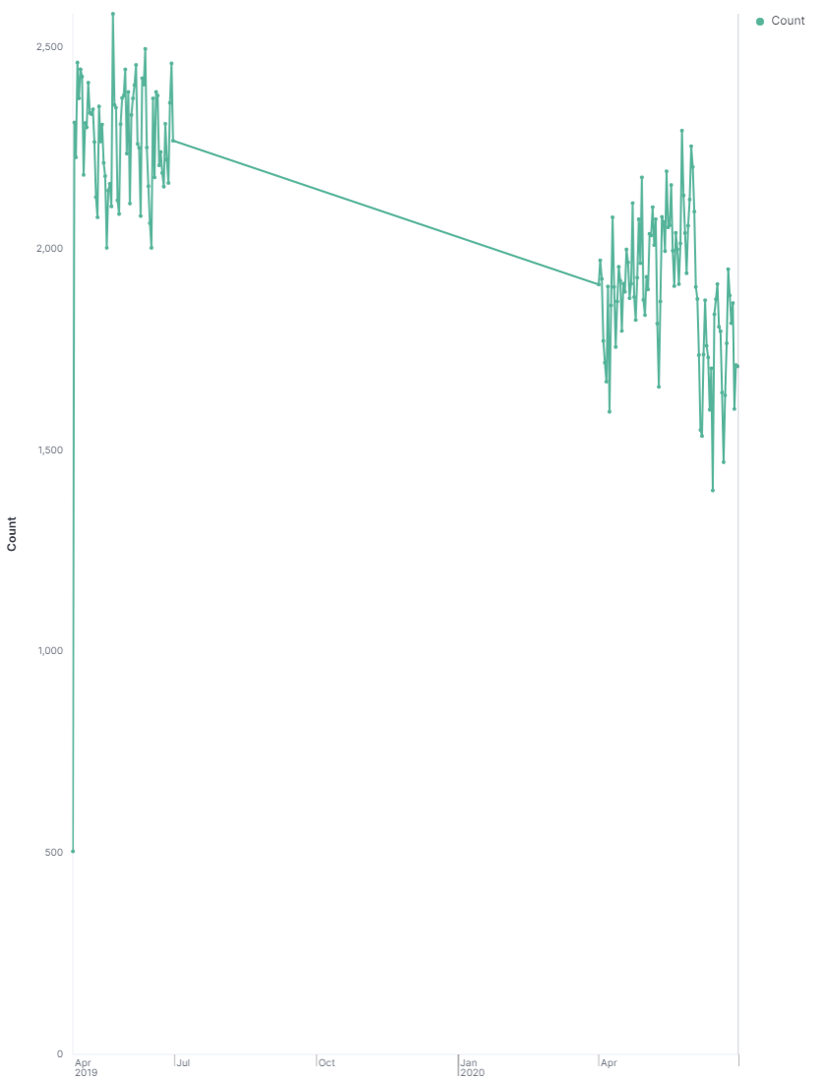
Line Chart
One of the most significant advantages of a line chart is its simplicity.
It clearly shows the decline in the number of policy calls after the outbreak of the epidemic.

Slide 8
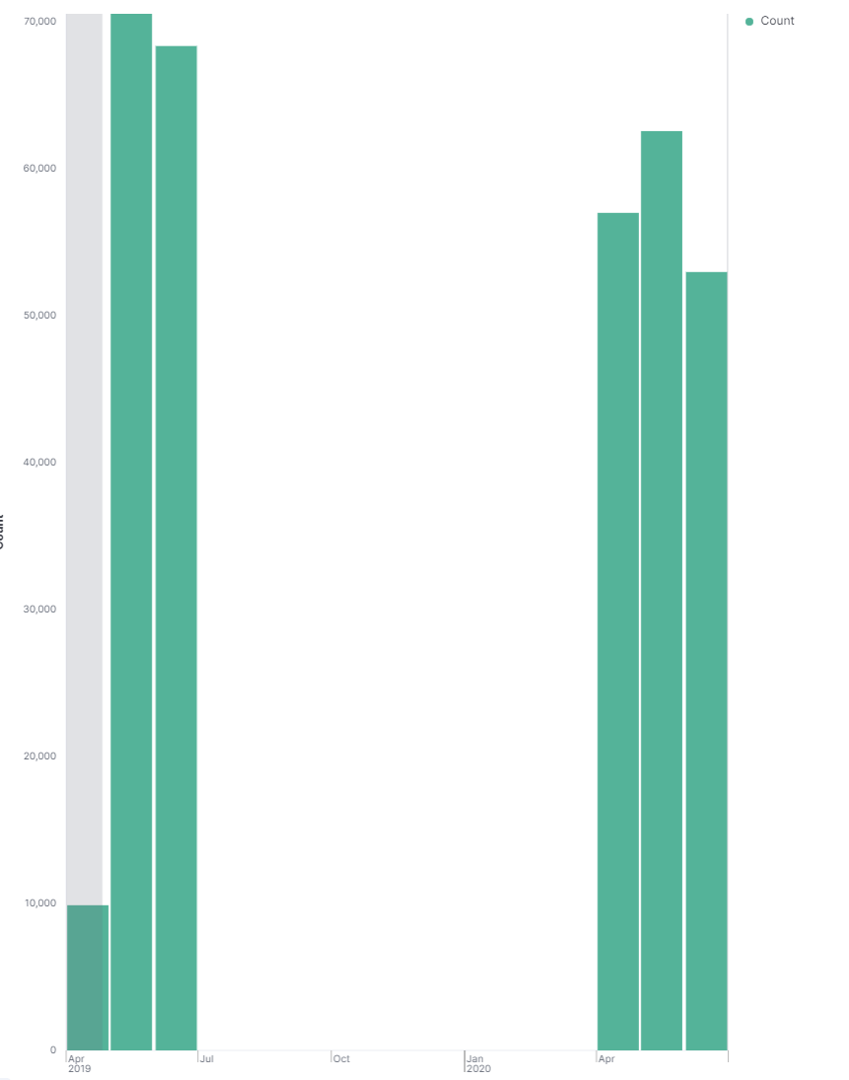
Vertical Bar
This graph visualizes the number of police calls between q2 2019 and q2 2020.

Slide 9
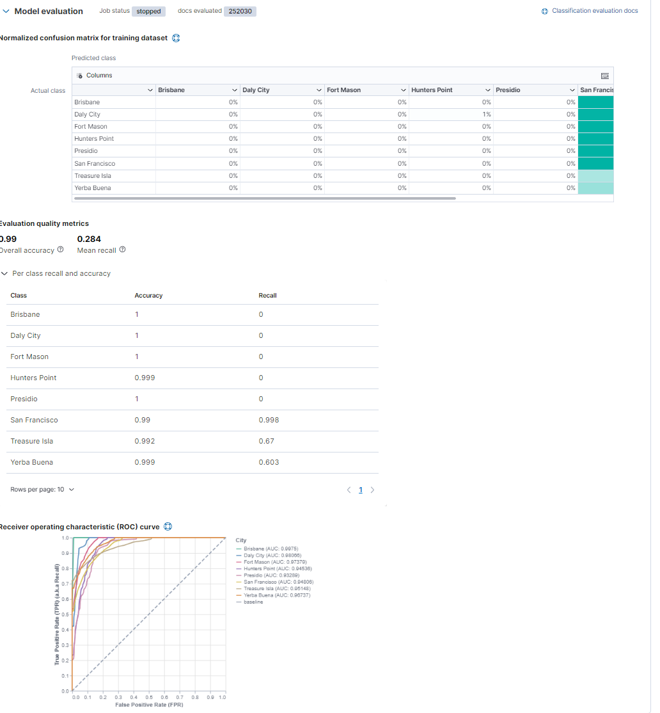
Machine Learning
Training data for Data Frame Analytics.

Slide 10
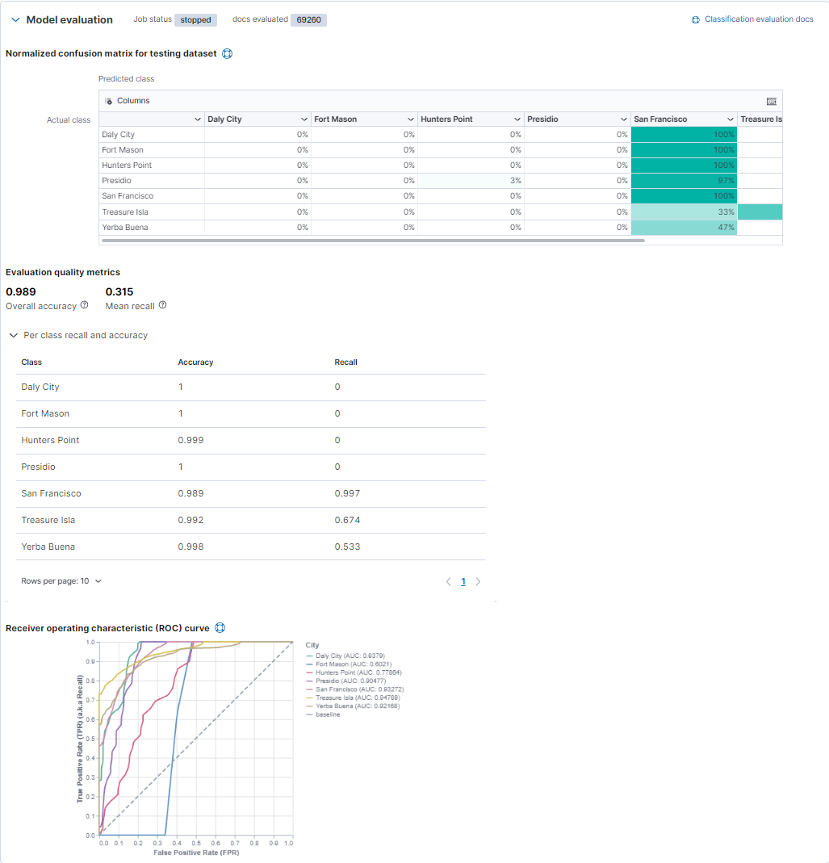
Machine Learning
Testing data for Data Frame Analytics.

Slide 11
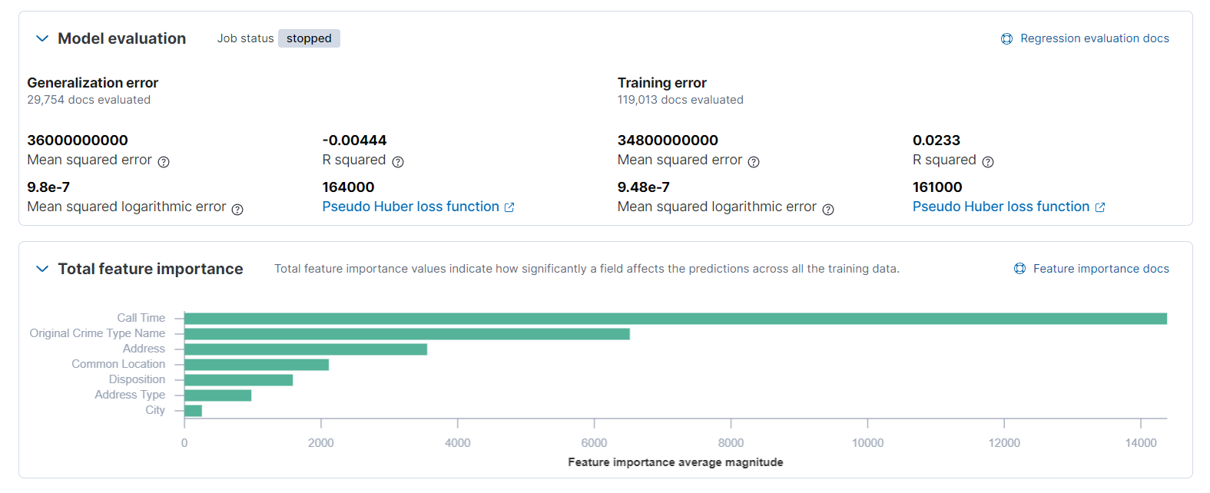
Regression Model Explore results for job ID crimeanalysis 2019

Slide 12
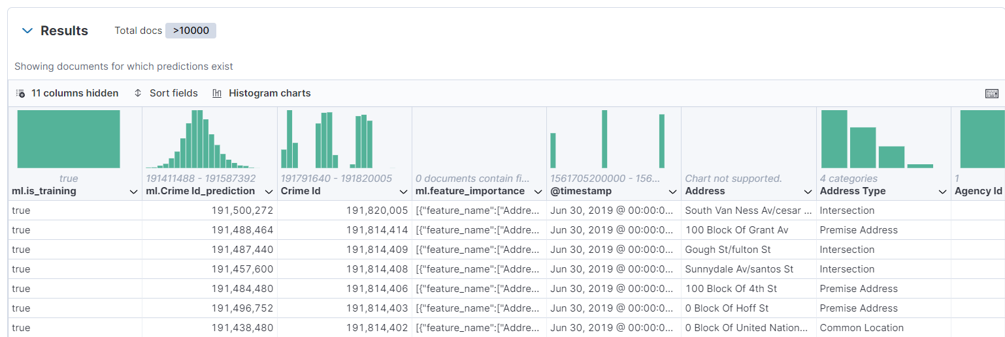
Prediction 2019

Slide 13
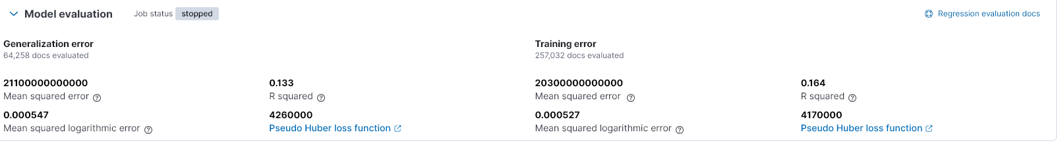
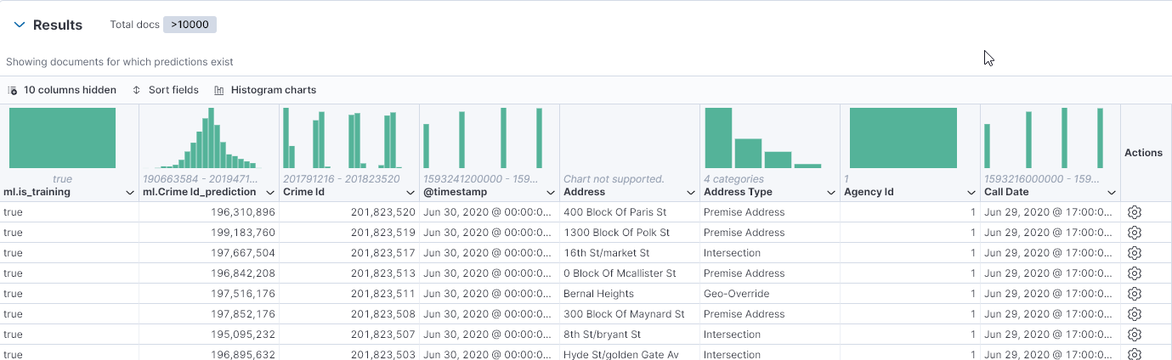
Regression & Prediction 2020

Slide 14

Conclusion
These data visualization tools provide us with very convenient methods to analyze the information we need in a very large amount of data.

